Slide 1

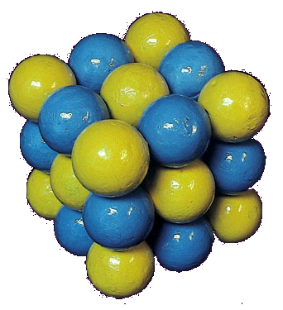

Chemical Bonding

Slide 2
Objectives
Identify the stable noble gas structure.
Explain the formation of ionic and covalent bonds.
State the properties of ionic and covalent bonds.

Slide 3
Stable Noble Gas Structure
Where can noble gas be found?
They are gases found in Group 0 of the Periodic table.
For instance, helium, neon, argon and etc.

Slide 4
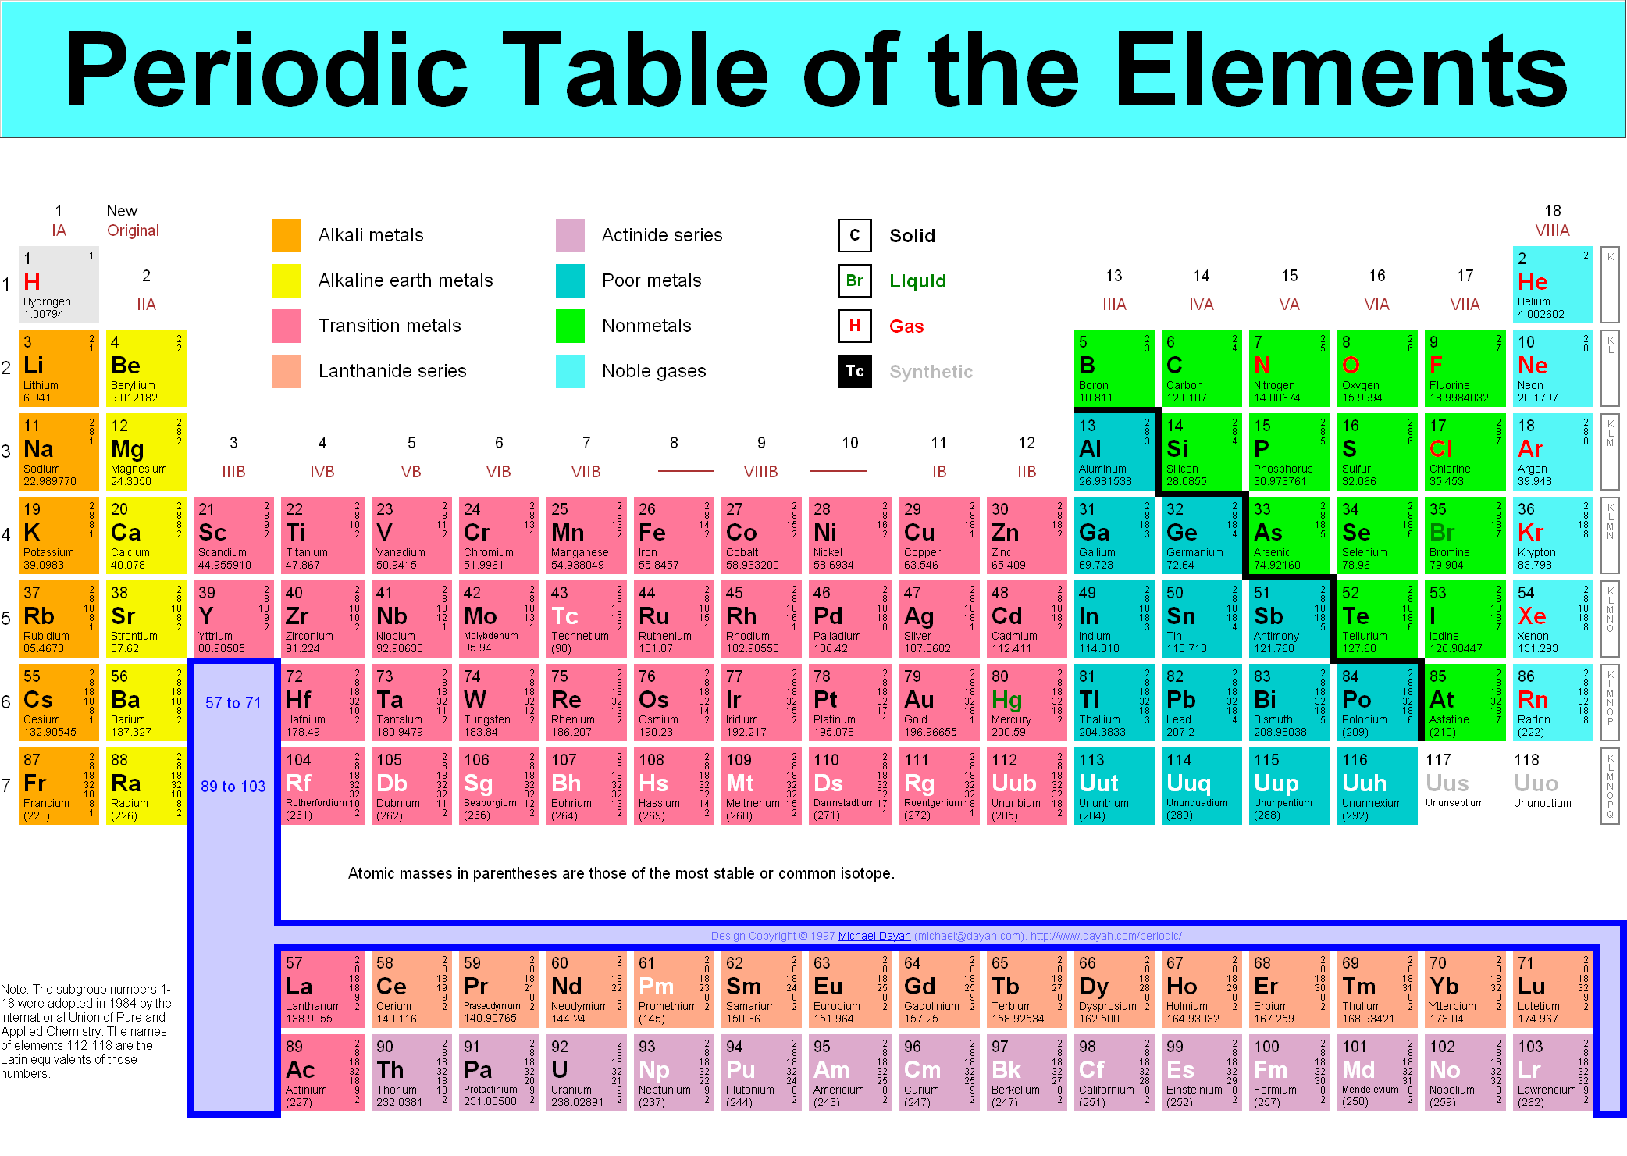

Slide 5



Stable Noble Gas Structure
What are noble gases?
They are gases which are unreactive or stable.
  Indicates that they do not react with other atoms to form compound.
Helium
Sodium
+

Slide 6
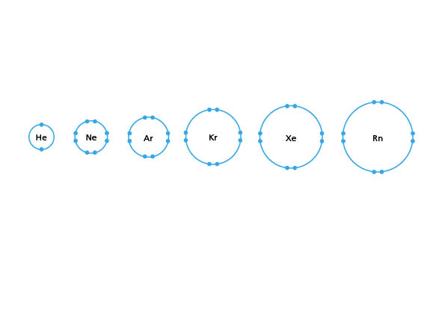
Why are noble gases unreactive?
The valence shells of noble gases are shown here.
Each noble gas has a fully filled valence shell.

Slide 7
Noble Gas
Why are noble gases unreactive?
Noble gases have duplet or octet configuration.
Therefore, they do not need to react to
become stable.
Duplet configuration
Octet configuration

Slide 8
Noble Gas Structure
A duplet or octet configuration is also known as a noble gas structure or
a noble gas configuration.

Slide 9
Noble Gas Structure
Why are the other atoms reactive?
Other atoms do not have a noble gas configuration.
Therefore, atoms react in order to have the noble gas structure.

Slide 10
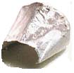


Chemical Bonding
What is chemical bonding?
Chemical Bonding is the way in which atoms join together with each other.
 | +
sodium metal |  | chlorine gas |  | table salt

Slide 11
Chemical Bonding
During a chemical reaction, atoms of the elements joined together to form ionic compound or covalent compound.
Ionic Compound
Covalent Compound

Slide 12
Chemical Bonding
Two types of chemical bonding:
Ionic bonding- between metals and non- metals
Covalent bonding – between non-metals

Slide 13
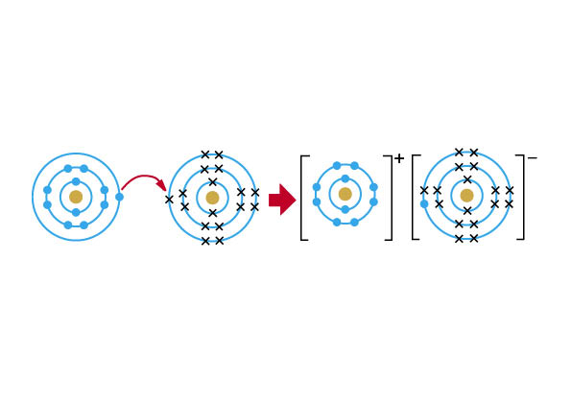
Ionic bonding
What is ionic bonding?
Ionic bonding involves transferring of electrons from metal to non-metal.

Slide 14
Ionic Bonding
During bonding
Metallic atoms give away (lose) electrons and change into positive ions or cations.
Na
Na⁺ + e⁻
Metallic atom
Cation

Slide 15
Formation of a Sodium Ion
+
Lose 1 electron
sodium atom, Na
sodium ion, Na⁺
To attain an octet configuration,
a sodium atom (Na) loses
1 valence electron.
It forms a sodium ion (Na⁺) and has a noble gas structure.

Slide 16
Formation of a Sodium Ion
+
Lose one electron
sodium atom, Na
sodium ion, Na⁺
11 p
11 e
12 n
11 p
10 e
12 n

Slide 17
Ionic Bonding
During bonding
Non-metallic atoms take in (accept) electrons and change into negative ions or anions.
Cl + e⁻
Cl ⁻
Non-metallic atom
Anion

Slide 18
Formation of Chlorine ion
-
gains one electron
Chlorine atom, Cl
Chlorine ion, Cl⁻
A chlorine atom (Cl) gains an electron to form a chloride ion (Cl⁻).
The chloride ion has an octet configuration.

Slide 19
Formation of Chlorine ion
-
gains one electron
Chlorine atom
Chlorine ion, Cl⁻
17 p
17 e
18 n
17 p
18 e
18 n

Slide 20
Ionic Bonding
By taking in and giving out electrons, both the metallic and non-metallic atoms achieve a completely filled outermost shell.
Indicates they attain a stable noble
gas structure.
+
-

Slide 21
Ionic Bonding
The electrostatic force of attraction between the positive and negative ions is called an ionic bond.
Ionic bond

Slide 22
How do we show ionic bonding?
We show it through the ‘dot and cross’ diagram.
The diagram here shows the formation of an ionic bond in sodium chloride.
Na
Cl

Slide 23
Examples
Magnesium oxide
Calcium fluoride
Lithium oxide

Slide 24
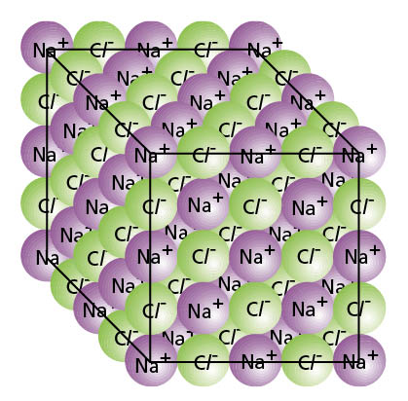
Structure of Ionic Compounds
All ionic compounds are solids with giant lattice structure.
They consist of positive ions of metals and negative ions of non-metals.
E.g. sodium chloride

Slide 25
Example: Sodium chloride
In a crystal of sodium chloride, Na+ and Cl- are held in fixed position by strong electrostatic force of attractions (ionic bonds)

Slide 26
Characteristics of ionic compounds
High melting and boiling point
  Ions are held firmly to their position by strong electrostatic force of attraction.
  A great amount of energy is needed to break these forces for the ions to move out of its fixed position to become a liquid.

Slide 27



Characteristics of ionic compounds
2. Solubility
  Soluble in water
  Insoluble in organic solvent (e.g. oil, ethanol, petrol)
Salt
Ethanol
(Insoluble)
Water
(soluble)

Slide 28
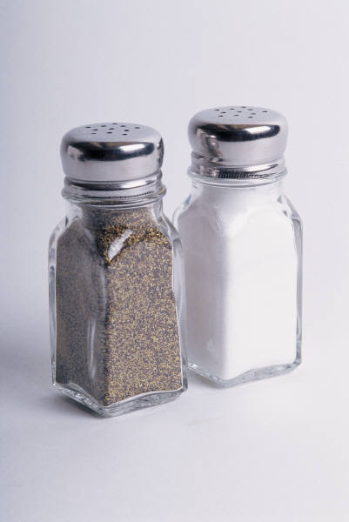




Characteristics of ionic compounds
3. Conducts electricity when molten (melted) or aqueous (dissolved in water) but not in solid state

Slide 29
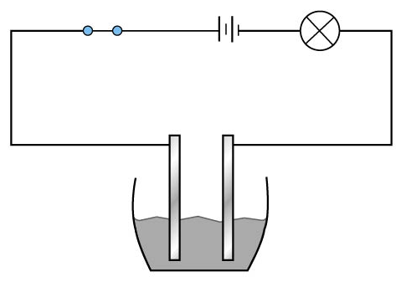
Electrical Conductivity
– in solid sodium chloride
Bulb does not light up.
In solid, the ions are held in fixed position. They cannot move freely.

Slide 30
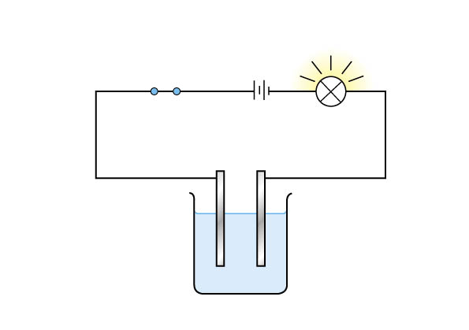
Electrical Conductivity
– in molten sodium chloride
However, if NaCl is heated until it melts…
Bulb lights up.

Slide 31
Electrical Conductivity
– in aqueous sodium chloride
Bulb lights up.
  In molten or aqueous, ions are free to move about, thus carry charges to conduct electricity.

Slide 32

Covalent Bonding

Slide 33
Covalent bonding
What is covalent bonding?
Covalent bonding involves sharing of electrons between non-metallic atoms.
H
H
Sharing of electrons
Transferring of electrons

Slide 34

Covalent bonding
During bonding,
The non-metallic atoms share electrons to achieve noble gas configuration.
H
H
2H atoms
H₂ molecule

Slide 35
Covalent Bonding
Rule 1:
Each atom must contribute an equal number of electrons for sharing.

Slide 36
Covalent Bonding
Which of the following diagrams obey the rule?
Y
Y
Y
Y
A
B

Slide 37
Covalent Bonding
Rule 2:
A shared pair of electrons forms a single covalent bond.
  1 pair of electrons → a single bond is formed.
  2 pairs of electrons → a double bond is formed.
  3 pairs of electrons → a triple bond is formed.

Slide 38
Covalent Bonding
A shared pair of electrons forms a single covalent bond.
Y
Y
Y
Y
‘Dot and cross’ diagram
(Electronic Structure)
Structural formula

Slide 39
Covalent Bonding
Two shared pair of electrons forms a double covalent bond.
Y
Y
Y
Y
‘Dot and cross’ diagram
(Electronic Structure)
Structural formula

Slide 40
Covalent Bonding
How do we show covalent bonding?
Through ‘Dot and Cross’ Diagram or
Structural formula
‘Dot and cross’ diagram
(Electronic Structure)
Structural formula
Y
Y
Y
Y

Slide 41
Covalent Bonding
Examples:
Hydrogen molecule
Oxygen molecule
Nitrogen molecule
Methane (CH₄)
Carbon dioxide
Water
Ammonia (NH₃)

Slide 42
Characteristics of Covalent Compounds
Low melting and boiling point
( high volatility)
  Molecules are held together by very weak intermolecular forces.
  Little energy is required to overcome the forces of attraction.

Slide 43
Characteristics of Covalent compounds
2. Solubility
  Soluble in organic solvent
  Insoluble in water.

Slide 44
Characteristics of ionic compounds
3. Does not conduct electricity in any state.
  Molecules in covalent compounds do not carry charges.
  No ions to carry electric current.

